Slide 1
Introduction to APIs
Presented by Joy Karani

Slide 2
agenda
API
HOW APIS WORK 4
BENEFITS OF API 7
API ARCHITECTURAL STYLES 10
Q&A SESSION 12

Slide 3
What is an API?
An API, which stands for application programming interface, is a set of protocols that enable different software components to communicate and transfer data.
Even though you can't see them, APIs are everywhere—working continuously in the background

Slide 4
How do APIs work?
APIs work by sharing data between applications, systems, and devices.
The request is sent to the API, which retrieves the data and returns it to the user.

Slide 5
Overview
1. API client
The API client is responsible for starting the conversation by sending the request to the API server.
ie user might initiate an API request by entering a search term or clicking a button.

Slide 6
Overview
2. API request
An API request will look and behave differently depending on the type of API, but it will have
endpoint, method, parameters, request headers, request body

Slide 7
Overview
3. API server
The API client sends the request to the API server, which is responsible for handling authentication, validating input data, and retrieving or manipulating data

Slide 8
Overview
4. API response
Finally, the API server sends a response to the client. The API response typically includes the following components:
Status code: HTTP status codes indicate the outcome of an API request.
ie 200 OK
Response headers: similar to request headers, except they are used to provide additional information about the server's response.
Response body: includes the actual data or content the client asked for or an error message if something went wrong.

Slide 9
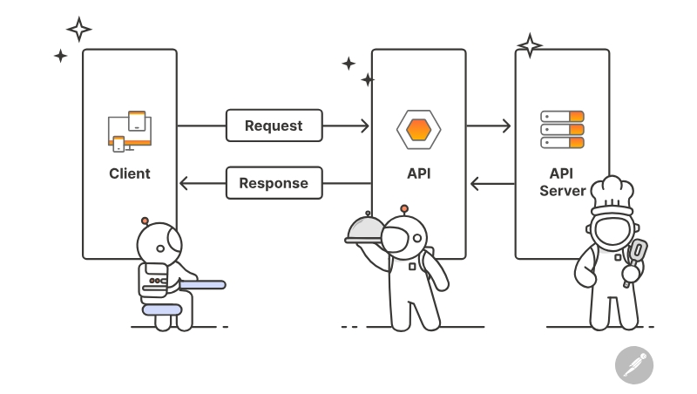
How APIs Work

Slide 10
Benefits of APIs
Automation: APIs can be used to automate repetitive, time consuming work so that humans can focus on more complex tasks. This improves productivity, especially for developers and testers.
Innovation: Public APIs can be used by external engineering teams, which spurs innovation and accelerates development by enabling developers to repurpose existing functionality to create new digital experiences.

Slide 11
Benefits of APIs
Security: APIs can provide an additional layer of protection against unauthorized breaches by requiring authentication and authorization for any request to access sensitive data.
Cost efficiency: APIs provide access to useful third-party tools and infrastructure, which helps businesses avoid the expense of building complex in-house systems.

Slide 12
API architectural styles
REST – most popular and has standard HTTP methods such as GET, POST, PUT, and DELETE.
SOAP - (Simple Object Access Protocol)
GraphQL - query language that enables clients to interact with a single API endpoint to retrieve the exact data
gRPC - Remote Procedure Call, and gRPC APIs were originated by Google

Slide 13

Live Coding Session
Step-by-step Coding Demonstration
Implementing fetch API

Slide 14
Q&A, final tips & takeaways
further LEARNING
POSTMAN – Beginner Guide to API

Slide 15

thank you

